Slide 1
Covalent Bonding
By Kai Song, Naresh, Robert, Adil, Shifa, Nurul, Sofea, Rina

Slide 2
A simple view of covalent bonding
The importance of noble gas structures
  At high school a lot of importance is attached to the electronic structures of noble gases like neon or argon which have eight electrons in their outer energy levels (or two in the case of helium). These noble gas structures are thought of as being in some way a "desirable" thing for an atom to have.
  You may well have been left with the strong impression that when other atoms react, they try to achieve noble gas structures.

Slide 3
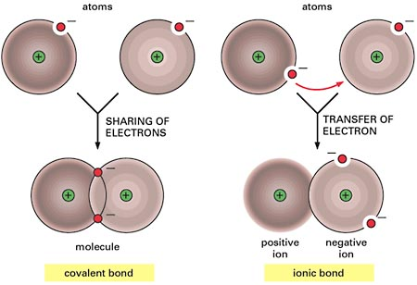
The importance of noble gas structures
  As well as achieving noble gas structures by transferring electrons from one atom to another as in ionic bonding, it is also possible for atoms to reach these stable structures by sharing electrons to give covalent bonds.

Slide 4
Simple Covalent Bond

Slide 5

COVALENT BONDING - SINGLE BONDS
Chlorine
Two chlorine atoms could both achieve stable structures by sharing their single unpaired electron as in the diagram.

Slide 6
The fact that one chlorine has been drawn with electrons marked as crosses and the other as dots is simply to show where all the electrons come from. In reality there is no difference between them.
The two chlorine atoms are said to be joined by a covalent bond. The reason that the two chlorine atoms stick together is that the shared pair of electrons is attracted to the nucleus of both chlorine atoms.

Slide 7

Hydrogen
Hydrogen atoms only need two electrons in their outer level to reach the noble gas structure of helium. Once again, the covalent bond holds the two atoms together because the pair of electrons is attracted to both nuclei.

Slide 8

Hydrogen Chloride
The hydrogen has a helium structure, and the chlorine an argon structure.

Slide 9
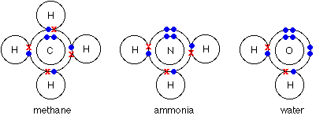
More Complicated Simple Bond

Slide 10
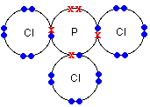
Even with a more complicated molecule like PCl₃, there's no problem. In this case, only the outer electrons are shown for simplicity. Each atom in this structure has inner layers of electrons of 2,8. Again, everything present has a noble gas structure.

Slide 11
Cases that throw up problems ☹
The only thing which must be changed is the over-reliance on the concept of noble gas structures. Most of the simple molecules you draw do in fact have all their atoms with noble gas structures.

Slide 12
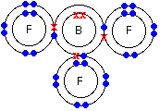
Boron trifluoride, BF₃
A boron atom only has 3 electrons in its outer level, and there is no possibility of it reaching a noble gas structure by simple sharing of electrons. Is this a problem? No. The boron has formed the maximum number of bonds that it can in the circumstances, and this is a perfectly valid structure.

Slide 13
Energy is released whenever a covalent bond is formed. Because energy is being lost from the system, it becomes more stable after every covalent bond is made. It follows, therefore, that an atom will tend to make as many covalent bonds as possible. In the case of boron in BF₃, three bonds is the maximum possible because boron only has 3 electrons to share.
Note: You might perhaps wonder why boron doesn't form ionic bonds with fluorine instead. Boron doesn't form ions because the total energy needed to remove three electrons to form a B³⁺ ion is simply too great to be recoverable when attractions are set up between the boron and fluoride ions.

Slide 14
Phosphorus(V) chloride, PCl₅
In the case of phosphorus 5 covalent bonds are possible - as in PCl₅. However, the compound is stable.
Phosphorus forms two chlorides - PCl₃ and PCl₅. When phosphorus burns in chlorine both are formed - the majority product depending on how much chlorine is available. We've already looked at the structure of PCl₃.

Slide 15
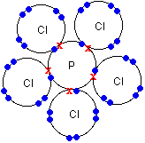
The diagram of PCl₅ (like the previous diagram of PCl₃) shows only the outer electrons.
Notice that the phosphorus now has 5 pairs of electrons in the outer level - certainly not a noble gas structure.

Slide 16
Multiple Covalent Bond

Slide 17
Definition
Atoms that are bonded together by sharing more than one pair of electrons
Two types of multiple bonds : double and triple bonds
A double bond is represented by a double line between the atoms, e.g O=O; a triple bond with 3 lines and so forth

Slide 18
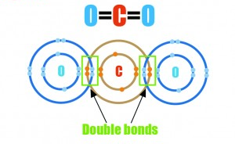
Examples of Double Covalent Bonds
Carbon Dioxide

Slide 19
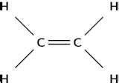
Example of Double Carbon Atoms
Ethene – double bond between carbon atoms

Slide 20
Nitrogen
Nitrogen is a diatomic molecule and has five valence electrons, so it needs three more valence electrons to complete its octet.
A nitrogen atom can fill its octet by sharing three electrons with another nitrogen atom, forming three covalent bonds, a so-called triple bond. The triple bond formation of nitrogen is shown in the following figure.

Slide 21
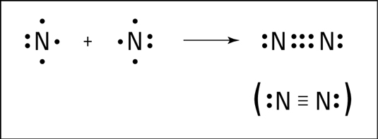
Triple bond formation of nitrogen
A triple bond isn’t quite three times as strong as a single bond, but it’s a very strong bond. In fact, the triple bond in nitrogen is one of the strongest bonds known. This strong bond is what makes nitrogen very stable and resistant to reaction with other chemicals.

Slide 22

It’s also why many explosive compounds (such as TNT and ammonium nitrate) contain nitrogen. When these compounds break apart in a chemical reaction, nitrogen gas is formed, and a large amount of energy is released.

Slide 23
SIGMA AND PI BOND

Slide 24
→Sigma bond is formed when there is linear ( head on) collision between atomic orbitals along the internuclear axis.
→The electron density is concentrated between the nuclei of the atoms forming the bond.
The bond can be rotated without breaking.
→Pi bond is formed when there is sideway overlap between p orbitals perpendicular to the internuclei axis.
The electron density is concentrated above and below the the line joining the nuclei of the atoms.
→ The bond cannot be rotated

Slide 25
Dative Coordinate Bond

Slide 26
Generally..
A covalent bond is formed by two atoms sharing a pair of electrons. The atoms are held together because the electron pair is attracted by both of the nuclei.
A co-ordinate bond (also called a dative covalent bond) is a covalent bond (a shared pair of electrons) in which both electrons come from the same atom.

Slide 27
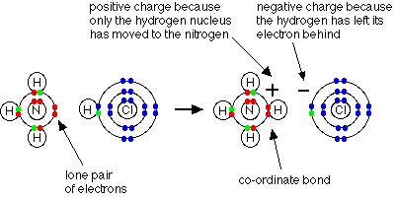
The reaction between ammonia and hydrogen chloride
If these colourless gases are allowed to mix, a thick white smoke of solid ammonium chloride is formed.
Ammonium ions, NH₄⁺, are formed by the transfer of a hydrogen ion from the hydrogen chloride to the lone pair of electrons on the ammonia molecule.

Slide 28

Representing co-ordinate bonds
In simple diagrams, a co-ordinate bond is shown by an arrow. The arrow points from the atom donating the lone pair to the atom accepting it.

Slide 29

The structure of aluminium chloride
AlCl₃ is electron deficient. It has a structure of

Slide 30
Dimer
It exists as a dimer (two molecules joined together).
The bonding between the two molecules is co-ordinate, using lone pairs on the chlorine atoms. Each chlorine atom has 3 lone pairs, but only the two important ones are shown in the line diagram.

Slide 31
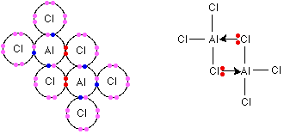
Structure of Al2cl6

Slide 32


